Slide 1
Mini Project: Google Search analysis
Name: Devika Dhumal
Roll No: 19
LP1

Slide 2
index
Problem Statement
Introduction
Approach
Code and Analysis
Conclusion

Slide 3
Problem Statement
TITLE: Google Search Analysis
Objective:
To understand where and what are the trending topics around the world.
To implement visualization for better understanding of our analysis
Expected Outcome:
Visualized and analyzed list of countries having the most searched approximate searches regarding the trending word.

Slide 4

introduction
Approximately 3.5 billion searches are performed on Google daily, which means that approximately 40,000 searches are performed every second on Google. So Google search is a great use case for analyzing data based on search queries. With that in mind, in this article, I will walk you through the task of Google search analysis with Python.

Slide 5
approach
Install/Import Needed Libraries
Pytrends,
Analyze the Google Trend
Using trends module from Pythrends
Final Analysis Visualization
For better understanding for our analysis
Matplotlib
Pandas,

Slide 6
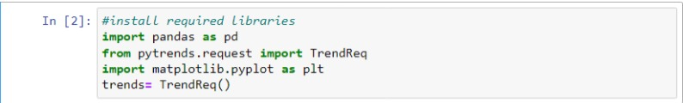
Code and analysis
Import the needed Libraries
Google Trends provides an API that can be used to analyze the daily searches on Google.
This API is known as pytrends.

Slide 7
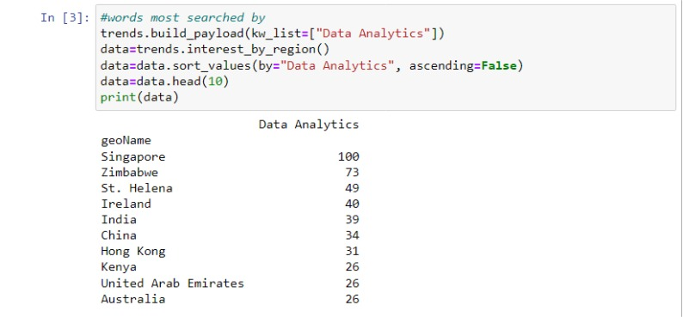
Code and analysis
Here we will be analyzing the Google search trends on the queries based on “Data Analytics”, so let’s create a DataFrame of the top 10 countries which search for “Data Analytics” on Google.
So, according to the above results, the search queries based on “Data Analytics” are mostly done in Singapore.

Slide 8
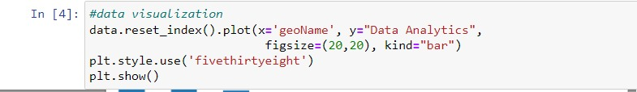
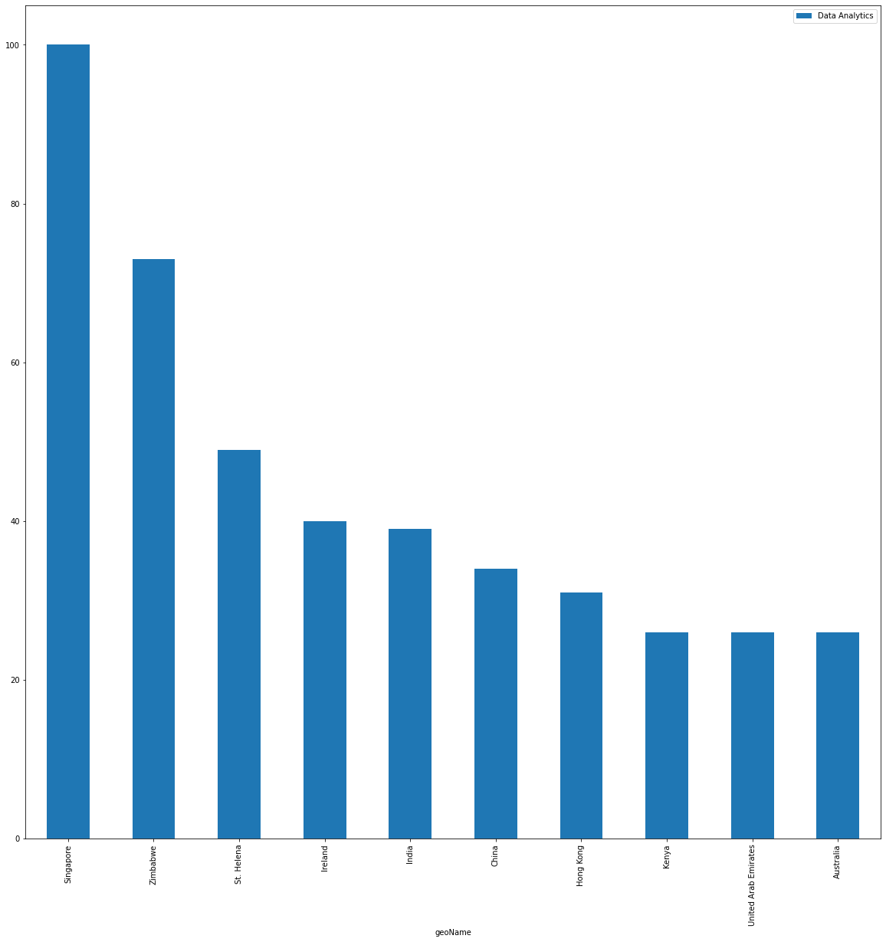
Code and analysis
Bar Graph gives us a visualized representation of top 10 countries with the most searches with respect to our given trend work

Slide 9
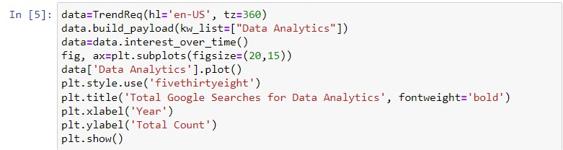
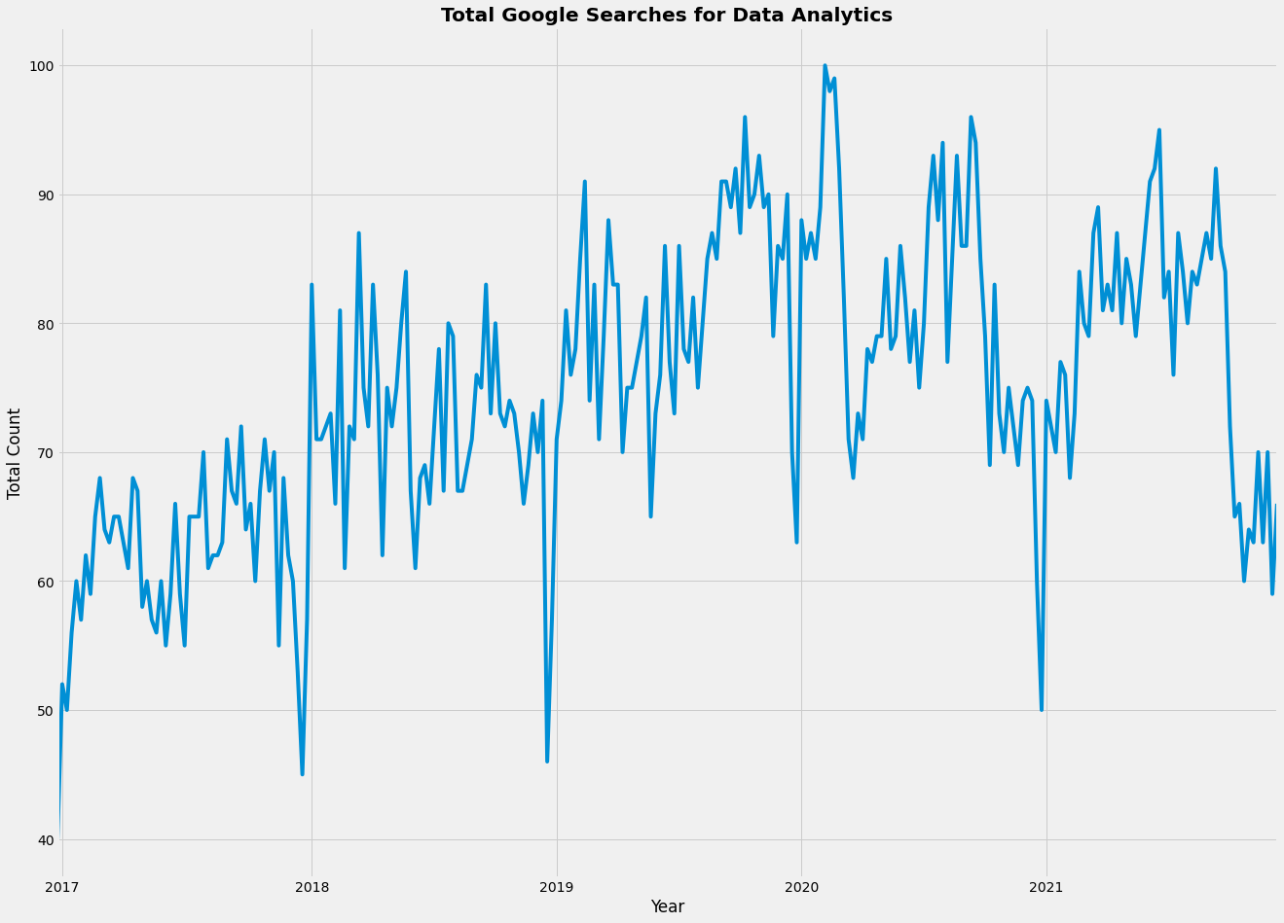
Code and analysis
So as we all know that Data Analytics has been the focus of so many companies and students for the last 3-4 years, so let’s have a look at the trend of searches to see how the total search queries based on “Data Analytics” increased or decreased on Google

Slide 10

conclusion
So we can see that searches based on “Data Analysis” on Google started to increase in 2017 and the highest searches were done in 2020 till today.
This is how we can analyze Google searches based on any keyword.
A business can perform Google search analysis to understand what people are looking for on Google at any given time.

